Slide 1
Eniac
Exploration of the discount strategy
Pandas@Work
Notes:
Eniac’s Marketing Team is convinced that offering discounts is beneficial in the long run, improving customer acquisition, satisfaction and retention. The Board of Investors are worried about offering aggressive discounts, as the recent quarterly results showed an increase in number of orders but a decrease in the total revenue.

Slide 2
Eniac is an online marketplace specializing in Apple products & Apple-compatible accessories.
Notes:
As the digital adoption is increasing and 37 million Spaniards are expected to buy things online by 2025. This trend also helps in bringing premium products closer to the consumers.

Slide 3
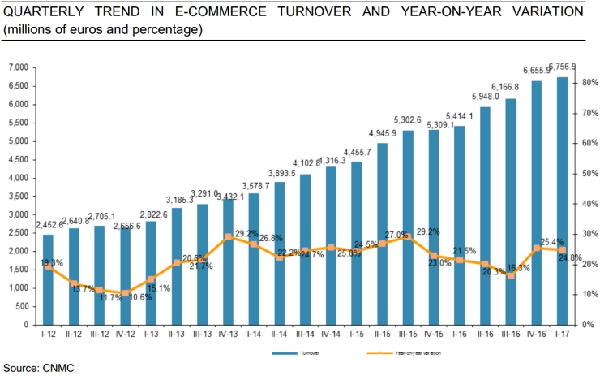
Spanish E-Commerce Market
Spain, together with Germany and France, is one of the 3 largest online markets in the EU.
In 2017, the overall e-commerce during Q1 2017 (115Mi transactions) increased by 24.8% year-on-year.
E-commerce market is growing rapidly.
The number of online buyers is projected to reach 37 million by 2025.
Consumer electronics remained one of the top categories for online purchases.
Spanish consumers are demanding, prioritizing free returns, quick delivery, and product quality.
Spanish consumers are highly price-conscious, often abandoning brands for cheaper alternatives (75% search for better deals).
Notes:
A study shows that e-commerce market is on the rise in Spain and is experiencing rapid growth. During the 1st quarter of 2017, e-commerce transactions increased by almost 25% on a YoY comparison.

Slide 4
Price Sensitivity and Consumer Behaviour Drivers lead to explore the discounts strategy at Eniac
Notes:
Because of the price sensitivity and consumer behaviour, a proper discount strategy is very much essential to attract the consumers to premium products without compromising on quality and revenue.

Slide 5
Product Categories
Though Eniac is an Apple based online marketplace, the platform hosts products from many other brands. Also, there is a diverse range of products available on the platform.

Slide 6
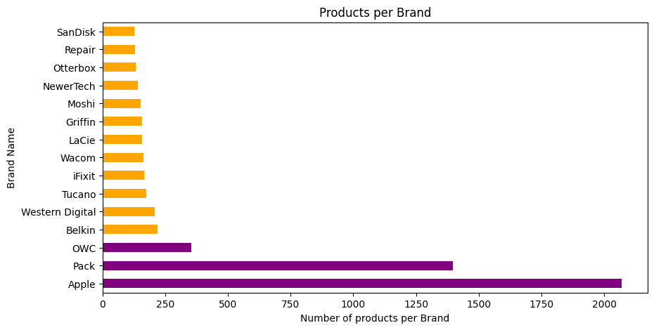

Slide 7
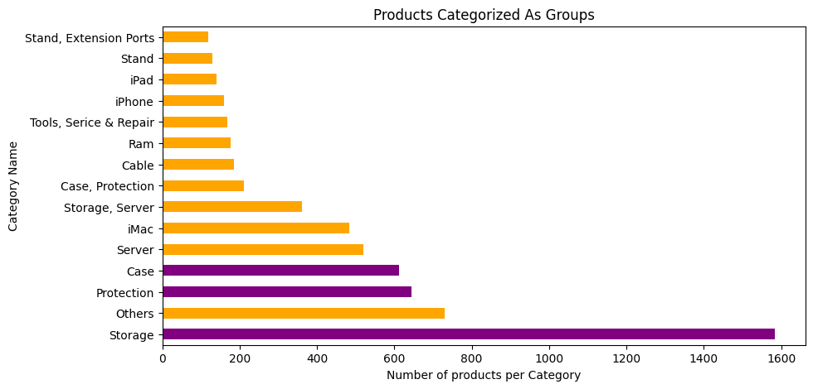

Slide 8
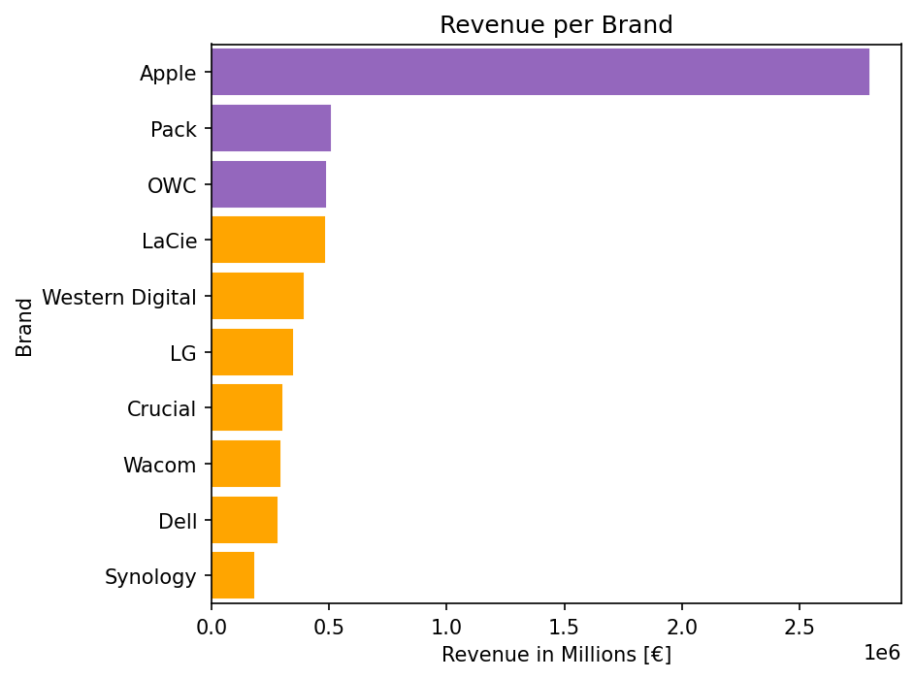
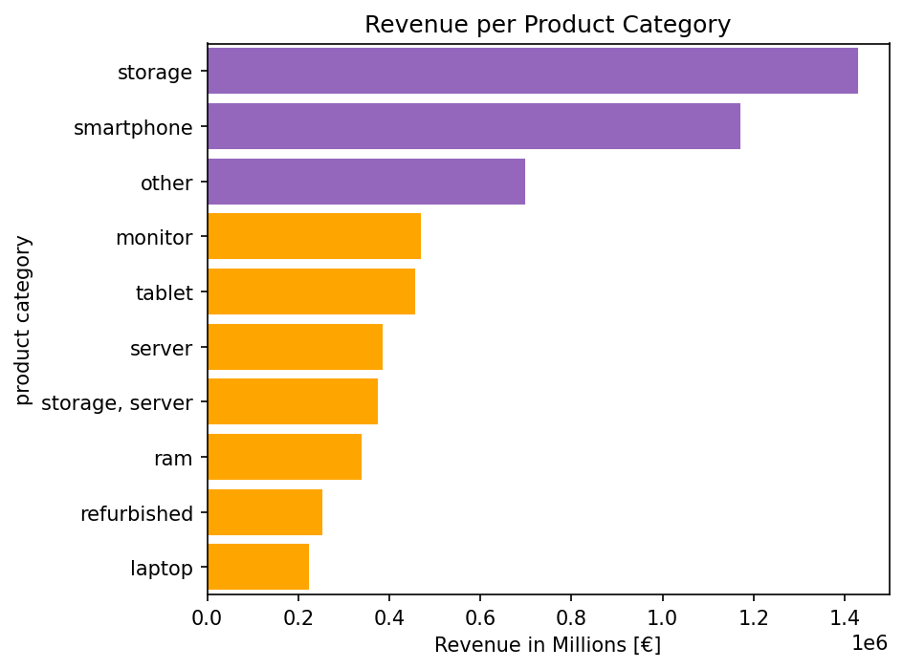
Revenues at Eniac

Slide 9
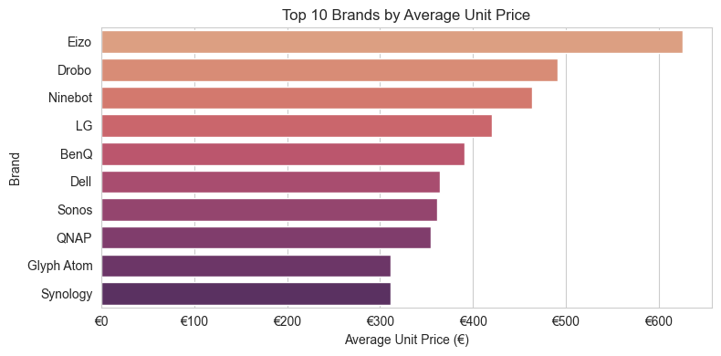
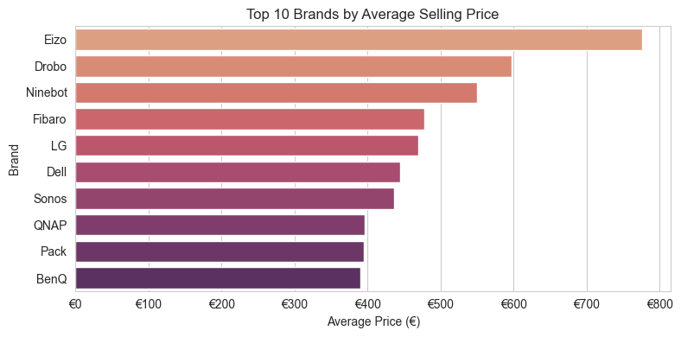
Average Product Prices

Slide 10
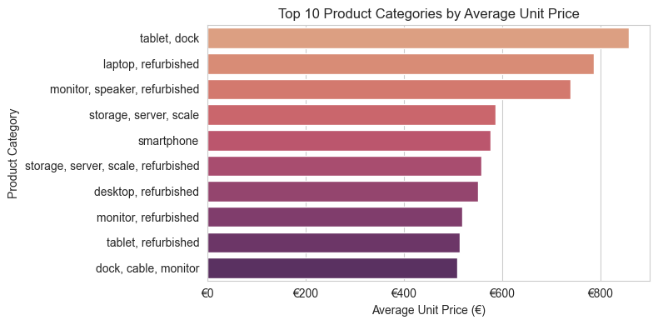
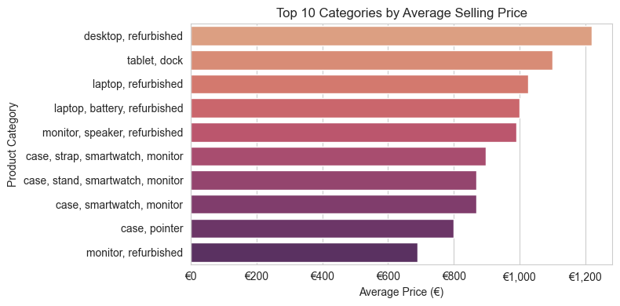
Average Product Prices

Slide 11
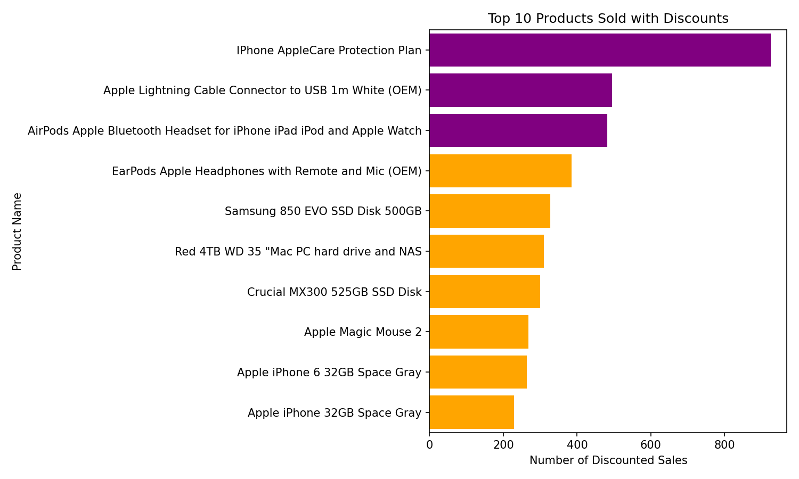
Discounts & Strategy

Slide 12
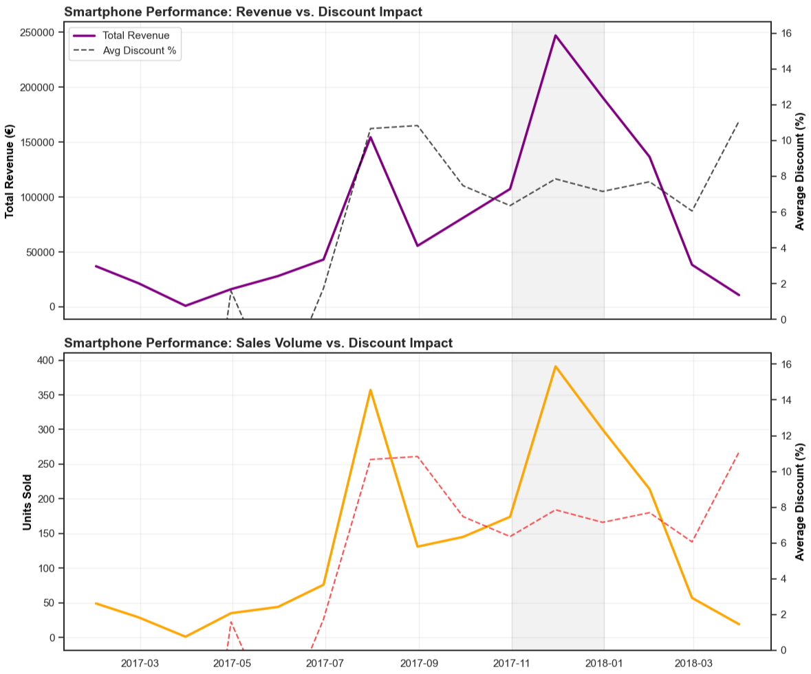
Smartphone Analysis: Strategic Timing vs. Discount Impact

Slide 13
Data Collection
Aspect | Issue
discounts | calculated based on available date and assumptions.
Cost | Actual cost of the products is not available.
Nan values | Were hindering the necessary calculations
Decimal separators | Too many mixed values with multiple decimals. Standardisation needed.
Product placement | Were placed in different categories (created outliers)
Small proportion of the working data | Out of ~270,000 lines of data only 50,000-60,000 lines (only completed orders) were considered for this analysis.

Slide 14
Conclusion
Thank you!!
We need more information to give a final conclusion as discounts prove to be both beneficial and detrimental as well!

